Slide 1
Semantics and ML
Semantic Integration Is What You Do Before The Deep Learning
Vladimir Alexiev, Chief Data Architect, Sirma AI (Ontotext)
dev.bg Machine Learning seminar, 13 May 2019, Sofia

Slide 2
Outline
Semantic Web and Linked Data
Knowledge Graphs
Ontotext Projects
Ontotext Demos
Use of Machine Learning

Slide 3
What is Semantic Web and Linked Open Data?
Semantic Web and Semantic Technologies
Exposing data and datasets to machines
Allowing machines to "understand" a bit of the data. Not giving a "higher meaning" to data
RDF, Ontologies, RDF Shapes
RDF: simple graph data model: triples (S,P,O), also quads (S,P,O,C=G)
RDFS and OWL Ontologies: describe classes, properties, subclasses, sub-properties, description logic constructs
RDF Shapes (Application Profiles): describe constraints on RDF data
May use with or without schema; the schema is part of the data
Linked Open Data
Expose datasets globally, making each entity/data point addressable (URL)
Use global identifiers not ambiguous names: "things not strings"
Link entities

Slide 4
Web 1.0, 2.0, 3.0
Web 1.0: linked documents (World Wide Web)
Before it there was ftp, gopher, online library catalogs…
Web 2.0: web applications, social web
Has Facebook taken over the web? New "decentralization" movement
Web 3.0: linked data (Giant Global Graph)
Metadata about documents, but also data about real-world entities: persons, organizations, hierarchy, projects, publications, companies, startups, transactions, networks, servers, printers, IoT things, etc

Slide 5
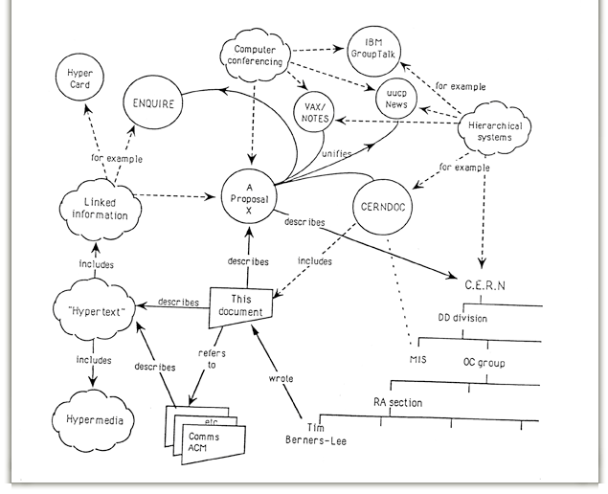
Where did it come from?
TimBL CERN proposal, 1989:
Both Web (1.0) and Semantic Web (3.0)
"Vague but Exciting"
Not just documents, but also real-world entities
Why was it successful?
Not the first nor the "best" hypertext proposal
But simple, workable, most importantly open

Slide 6
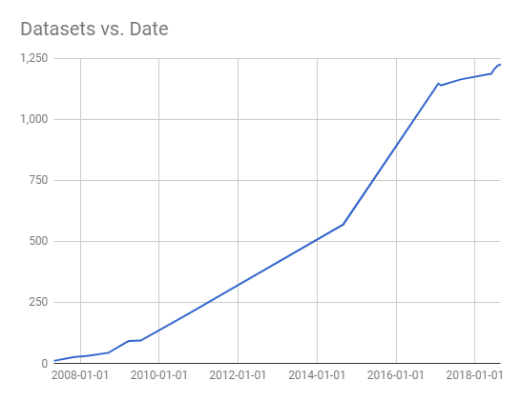
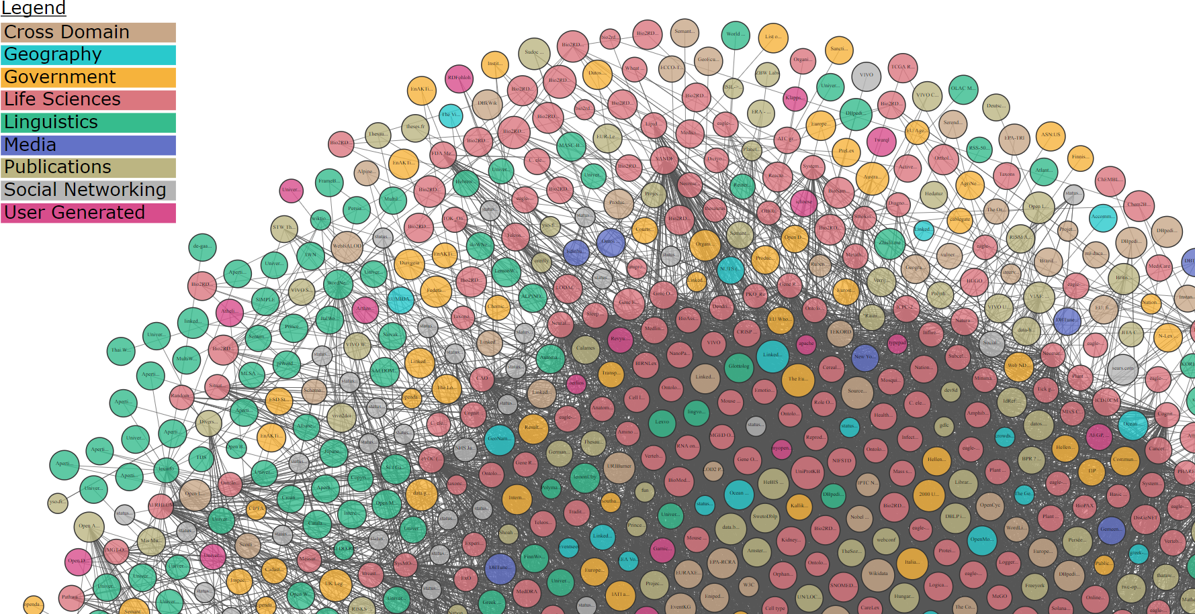
LOD Cloud
WebDataCommons Dec 2018: 30B triples

Slide 7
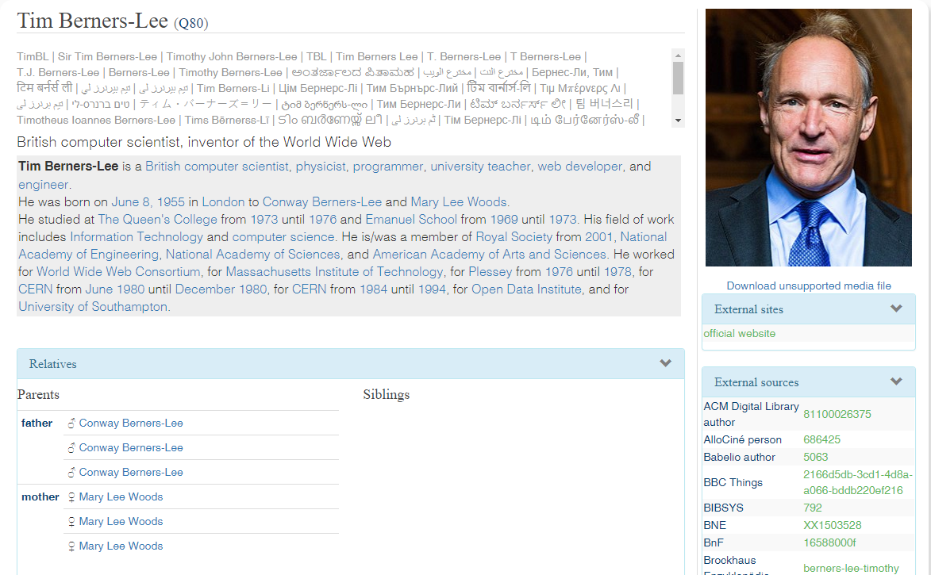
What does LOD know about TimBL?
TimBL at Wikidata Reasonator
Names in 50 languages
Description is auto-generated
Parents confirmed 3 times (with different details not shown)

Slide 8
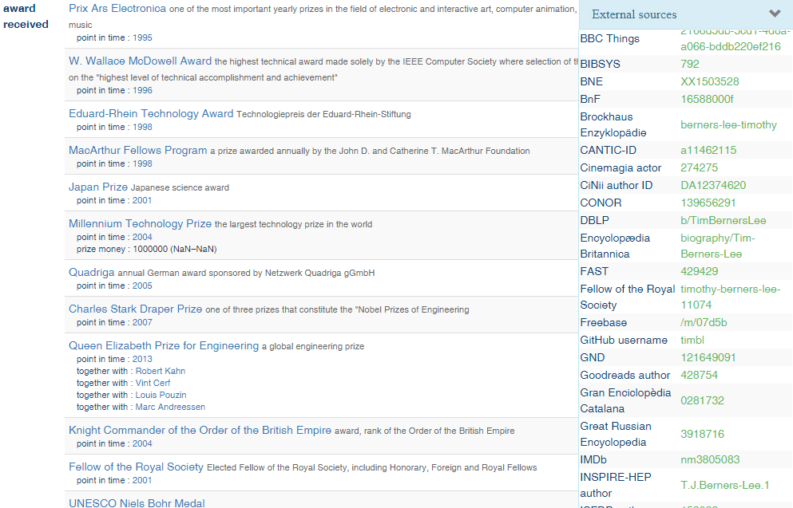
What does LOD know about TimBL?
Depth of Information on TimBL
Links to ~200 authority files
Info about ~20 awards
Life Timeline
etc, etc

Slide 9
Knowledge Graphs

Slide 10
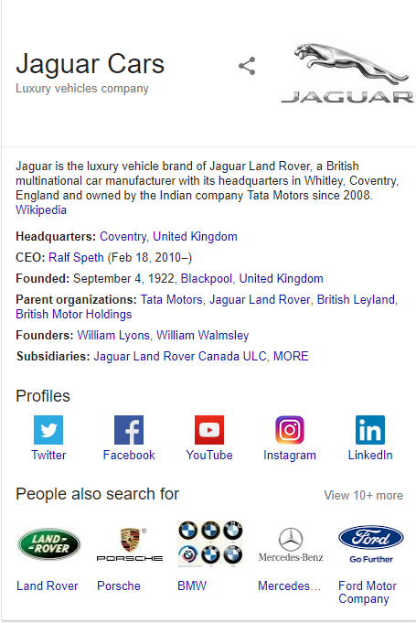
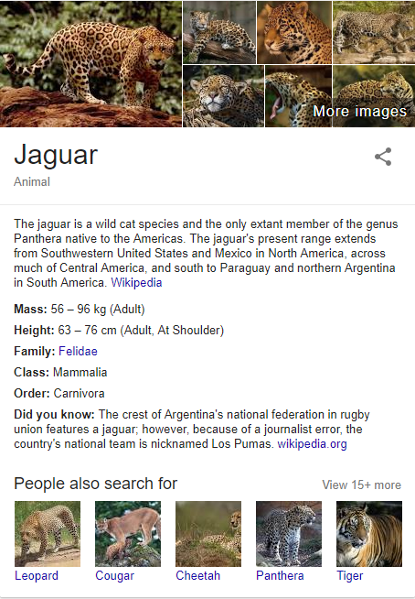
Google Knowledge Graph

Slide 11
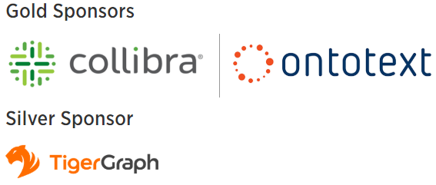
Everybody is Building a KG! KG Conference, 7-8 May, Columbia, NY
Health Care, Government, Supply Chain, Libraries
AstraZeneca - Fair Data Knowledge Graphs (From Theory to Practice)
Montefiore Hospital - The Chasm of a Million Analytics, and How to Bridge it?
United Nations - A Graph as a Means to Store Unpredictable Knowledge – A Practical Implementation
JSTOR Labs - Why Wikibase? Why not?
Eccenca - Knowledge Graph for Digital Transformation in the Supply-Chain
German National Library of Science and Technology - Creating a knowledge graph based Enterprise Innovation Architecture
How To...
Diffbot - Knowledge Graphs for AI
Accenture Labs - Using a Domain Knowledge Graph to Manage AI at Scale
Capsenta - Designing and Building Enterprise Knowledge Graphs from Relational Databases in the Real World
Google AI - Wikidata, Knowledge Graphs, and Beyond
IBM Research - Extending Knowledge Graphs using Distantly Supervised Deep Nets
Microsoft - Building a Large-scale, Accurate and Fresh Knowledge Graph
Neo4J - A Real-World Guide to Building Your Knowledge Graphs
Collibra - Collibra's Context Graph
Ontotext - How Analytics on Big Knowledge Graphs Help Data Linking: Company Importance and Similarity Demo
Digital Commerce
Airbnb - Knowledge Graph at Airbnb
Amazon - Deep Learning for Knowledge Extraction and Integration to build the Amazon Product Graph
Uber - Building an Enterprise Knowledge Graph at Uber: Lessons from Reality
Pitney Bowes - Intelligent Customer Service Using Knowledge Graphs
Financial Services
Causality Link - A Perspective on the Reasoning Power of Knowledge Graphs
Capital One - Knowledge Graph Pilot Provides Value
Goldman Sachs - Pythia: the Goldman Sachs Social Graph
TigerGraph - Analyzing Time-varying Transitive Risk in Swap Networks using Graphs
Refinitiv Financial - Practical Use Cases and Challenges to Implement Graphs in Financial Services: Combating Financial Crime
Wells Fargo - Knowledge Graphs and AI: The Future of Financial Data
Forensics
OCCRP - Using Graphs and Data Integration to Track Organised Crime
Enigma.io - Impact and Insights from Public Data: Fighting Money Laundering by Linking and Resolving Entities
Refinitiv Financial - Practical Use Cases and Challenges to Implement Graphs in Financial Services: Combating Financial Crime

Slide 12
KG & ML Literature & Seminars
Knowledge Graphs: New Directions for Knowledge Representation on the Semantic Web.
Dagstuhl Seminar 18371, Mar 2019
Grand Challenges: structure of knowledge & data and scale
Creation of Knowledge Graphs
Knowledge Integration at Scale
Knowledge Dynamics and Evolution
Evaluation of Knowledge Graphs
Combining Graph Queries with Graph Analysis
(Re)Defining Knowledge Graphs
NLP and Knowledge Graphs
ML and Knowledge Graphs
Human and Social Factors of Knowledge Graphs
Applications of Knowledge Graphs
Knowledge Graphs and the Web
Deep Learning for the Masses (… and The Semantic Layer), Favio Vázquez, Nov 20, 2018
Acknowledgement: my title is stolen from this blog post
4th Workshop on Semantic Deep Learning (SemDeep-4) at ISWC 2018
Big Data Semantics. Journal on Data Semantics, Apr 2018. DOI: 10.1007/s13740-018-0086-2
Forbes: Why Machine Learning Needs Semantics Not Just Statistics (Jan 2019)
Wired: Amazon Alexa and the Search for the One Perfect Answer (Feb 2019)

Slide 13
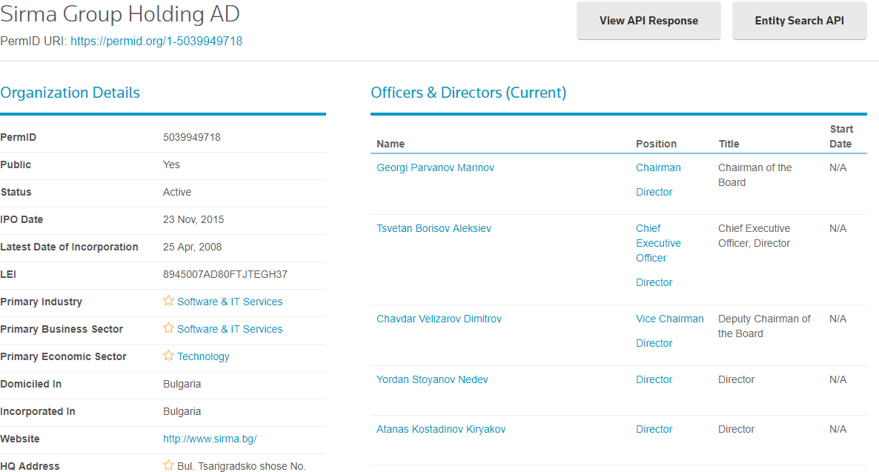
Thomson Reuters permid Company Graph

Slide 14
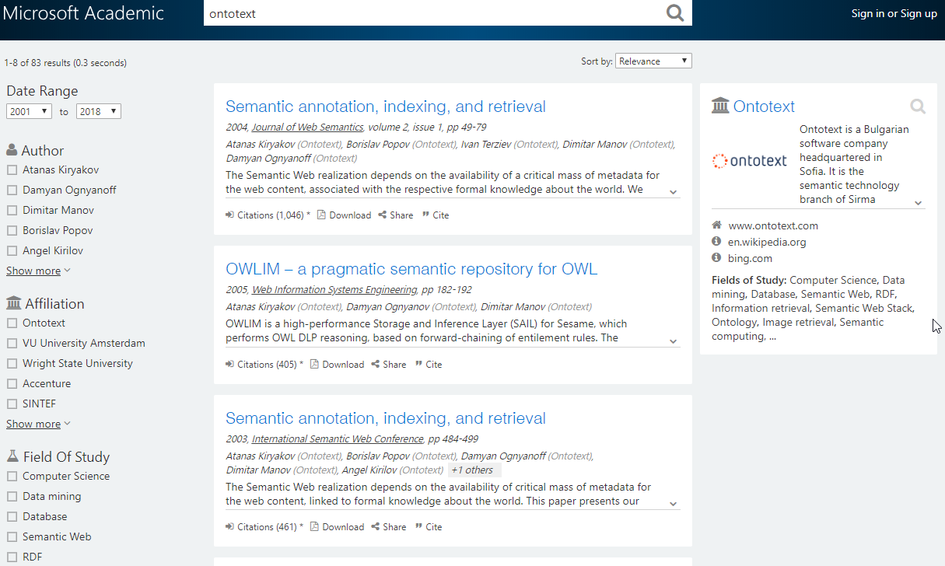
Microsoft Academic Graph

Slide 15
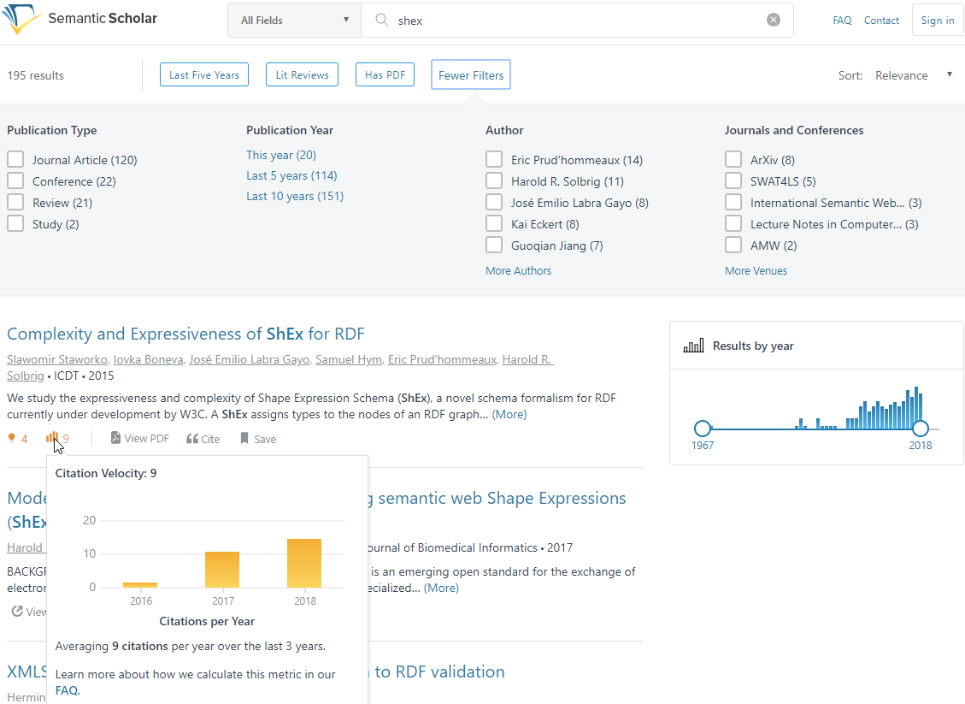
Semantic Scholar: search

Slide 16
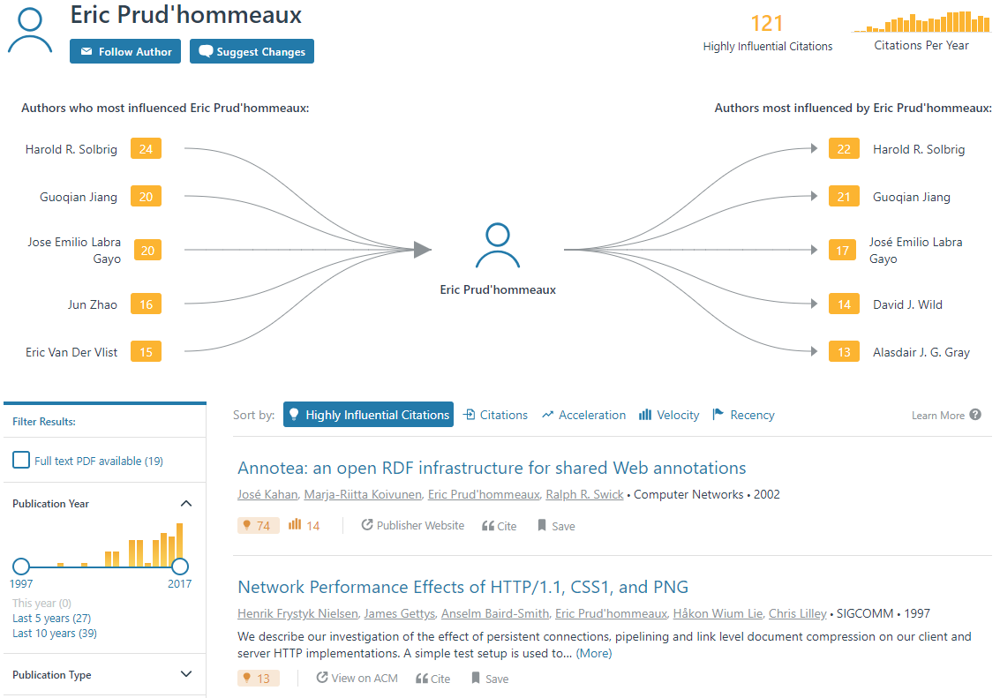
Semantic Scholar: Author Page

Slide 17
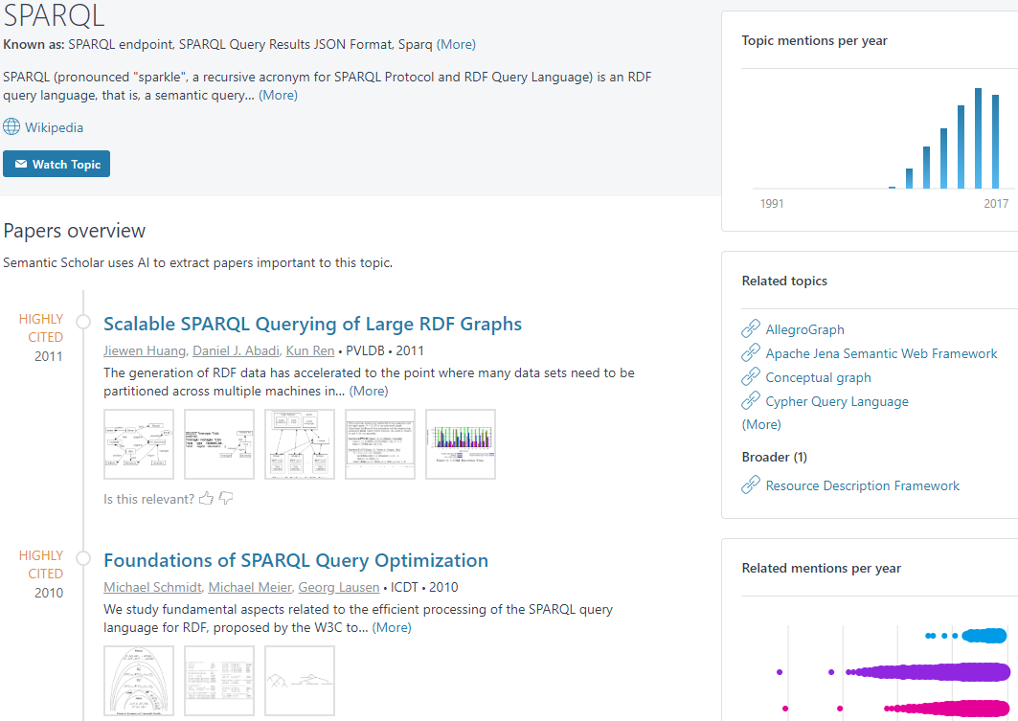
Semantic Scholar: Topic Page

Slide 18
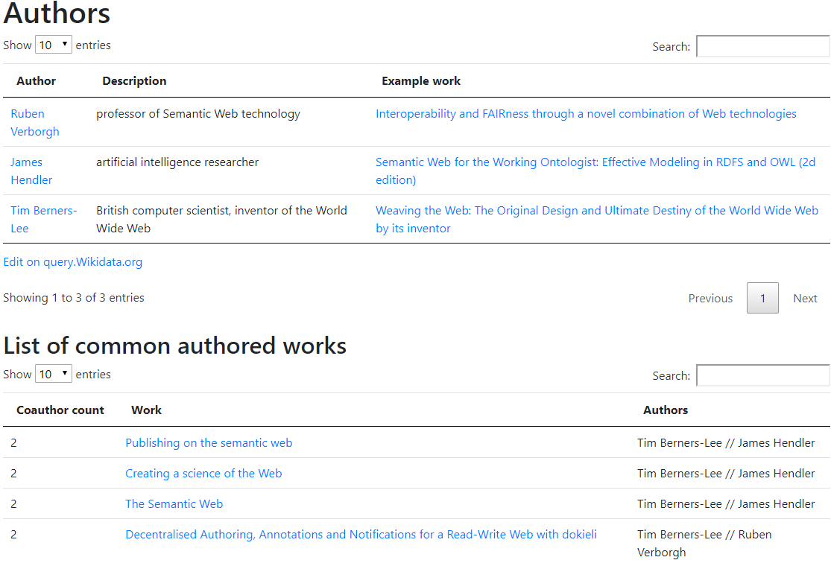
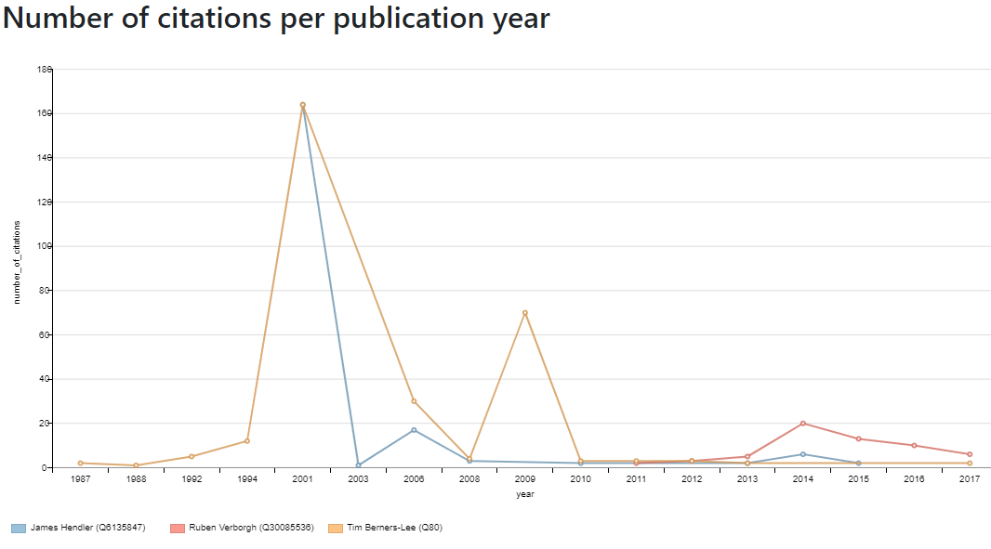
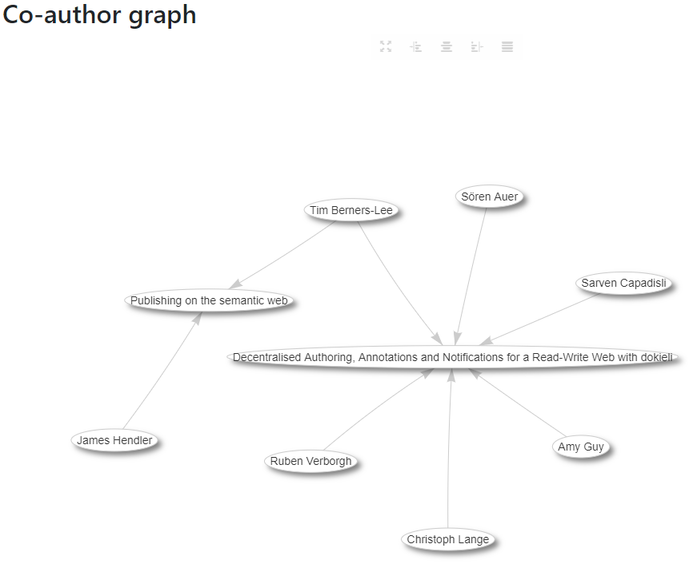
Wikidata Scholia: comparing authors
Scholia Example
Comparing three Semantic Web researchers: Tim Berners-Lee, James Hendler and Ruben Verborgh
#52

Slide 19
Sirma AI (Ontotext)

Slide 20
Ontotext Essential Facts
World-leading
Semantic technology vendor established year 2000
65 staff: 7 PhD, 30 MS, 20 BS, 6 university lecturers
Over 400 person-years invested in R&D
Part of Sirma Group: 400 persons, public company (BSE:SKK)
Profitable and growing
80% of revenue from commercial projects
Innovator
Attracted $15M in innovation funding
Trendsetter
Member of: W3C, EDMC (FIBO), ODI, LDBC, STI, DBPedia Association
Ontotext Innovation Awards
Innovative Enterprise of the Year 2017
EU Innovation Radar Prize 2016 nomination
BAIT Business Innovation Award 2014
Innovative Enterprise of the Year 2014
Washington Post “Destination Innovation” Competition 2014 Award
Pythagoras Award 2010
Most successful BG company in EU FP projects

Slide 21



























Some of Our Clients (selection)

Slide 22
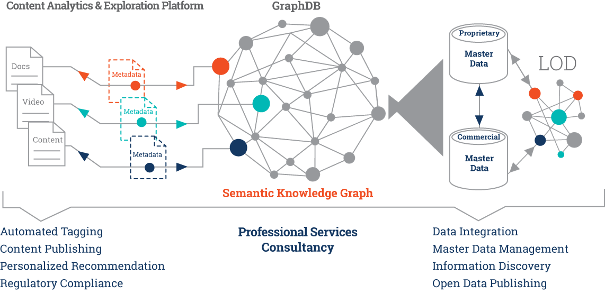
Ontotext Approach and Applications
Notes:
Start telling the story right to left: we combine LOD with proprietary master data; often we extend this with commercial master data, e.g. company data from vendors like D&B; this way we build a Big Knowledge Graph and manage it in our triplestore GraphDB. This KG provides the necessary entity awareness and context for accurate recognition and disambiguation of entities and concepts in text; the result of the text analysis is metadata – tags that describe the content by linking it to the appropriate nodes in the knowledge graph. This metadata is also stored in GraphDB to enable unmatched search and query across masterdata, content and metadata.
22

Slide 23
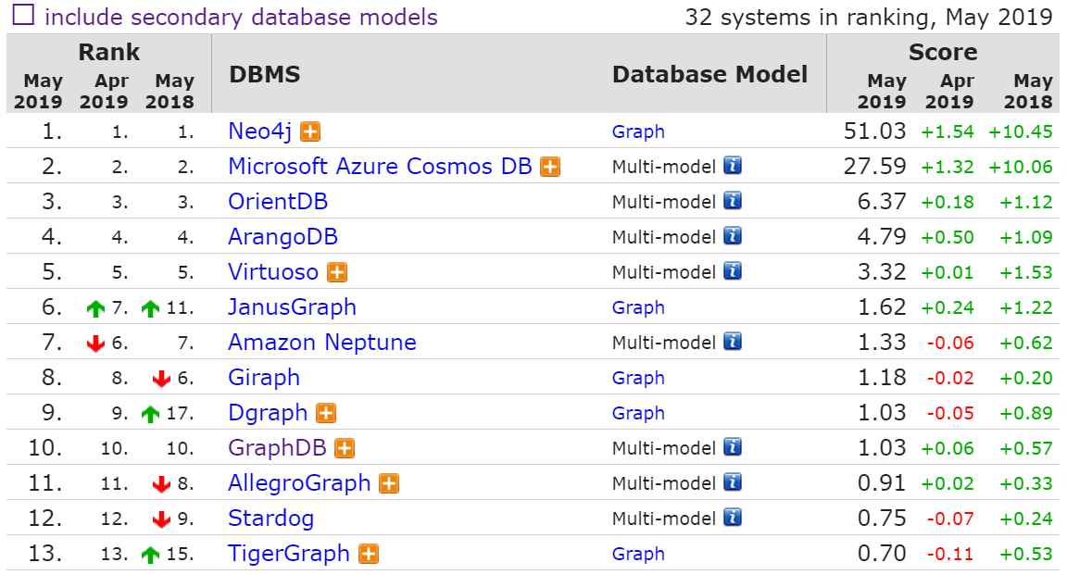
Ontotext GraphDB, a Leading Graph Database
Source: db-engines.com ranking of graph databases

Slide 24
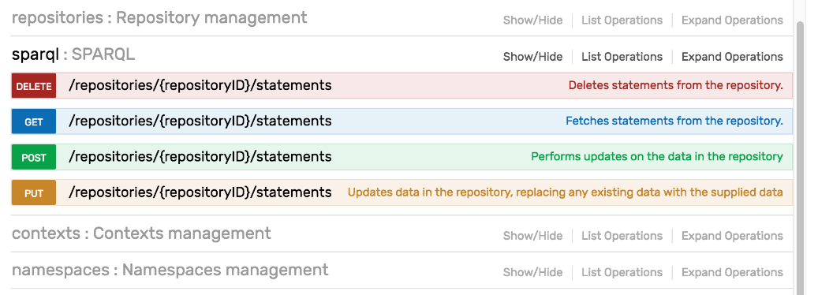
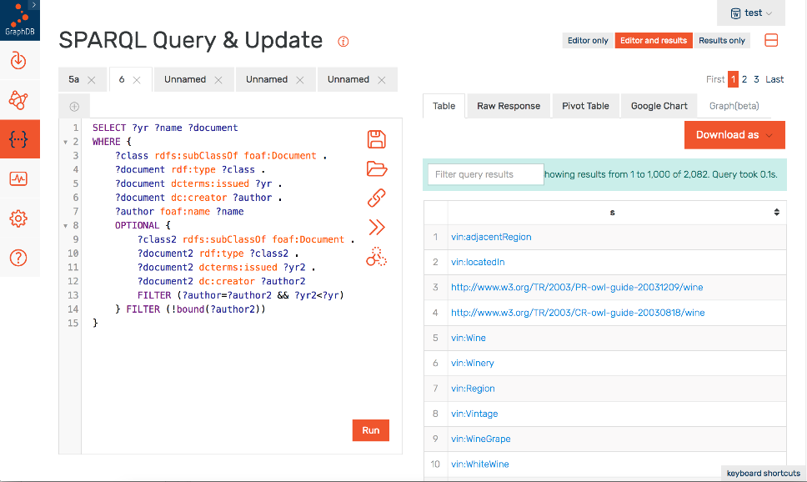


GraphDB Workbench: User-friendly DB admin and querying
REST API for database access
Plugins / Connectors
Notes:
GraphDB Workbench is the administrative interface shipped with the database. It gives the users an intuitive and powerful interface to the GraphDB Server. The Server exposes all database engine APIs. Unlike most of our competitors the engine allows easy extensibility and the development of Plugins. One such example are the Connectors, which synchronizes the internal RDF database model with external services like Lucene, SOLR, Elastic search

Slide 25
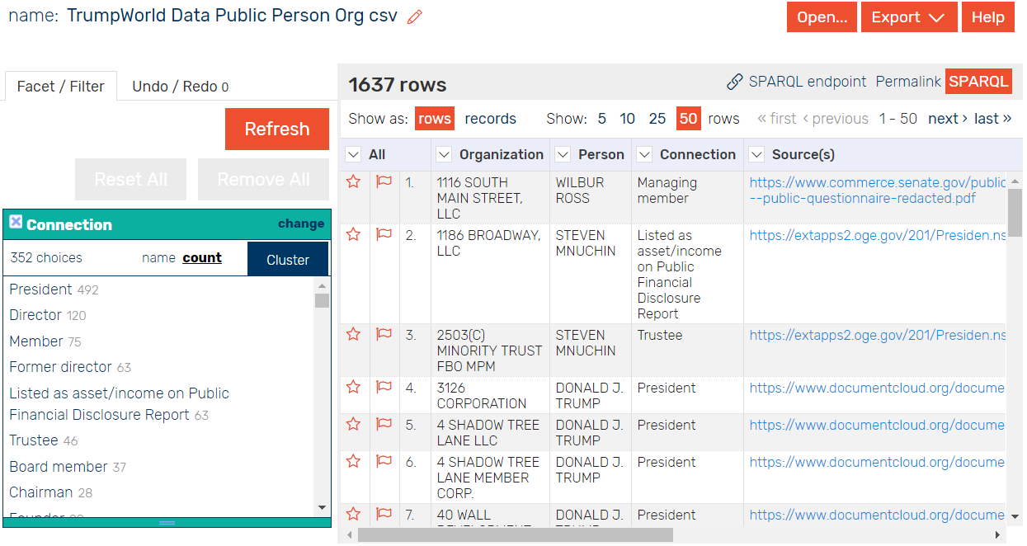
OntoRefine: Uplift Tabular Data to LOD
Easily clean and import tabular data
View as RDF in real-time with virtual SPARQL endpoint
Transform using JS & SPIN
Import newly created RDF directly to GraphDB

Slide 26
Knowledge Graph Platform Use Cases
Content enrichment
Who: STM publishers transforming their business model from publishing to information
Challenges: Control & generate meta-data
Reference projects: Elsevier, Wiley, IET, BBC, Euromoney
Semantic search of enterprise documents
Who: Enterprises with transactional document flows lacking analytic capabilities
Challenges: Integrate with existing CMS/DMS + security + analytics
Reference projects: Platts, AstraZeneca, Top-5 US bank, Top-5 German bank
Knowledge graph development and continuous updates
Who: Innovative businesses based on knowledge intensive processes
Challenges: Collect, integrate, and maintain complex knowledge graph, semantic search + analytics
Reference projects: Top Asian business information agency, Big-4 Consultant
Notes:
What are the different players on the market?
PaaS – sell hardware; offer services without or very minimal customization – take it or leave it
Text analytics companies - sell NLP with the ability to customize it with the client’s data
AI platform – customize everything with your data
Semantic technology – specializing in KG and related services

Slide 27
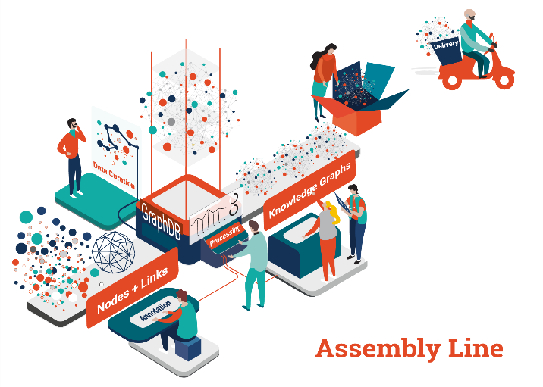
Semantic Data Integration

Slide 28

Example KG: FactForge
DBpedia (the English version) 496M
Geonames (all geographic features on Earth) 150M
owl:sameAs links between DBpedia and Geonames 471K
GLEI (global company register data) 3M
Panama Papers DB (#LinkedLeaks) 20M
Other datasets and ontologies: WordNet, WorldFacts, FIBO
News metadata (2000 articles/day enriched by NOW) 1 023M
Total size (2.2B explicit + 328M inferred statements) 2 522М
Notes:
FactForge is a hub for open data and news about people, organizations and locations.

Slide 29
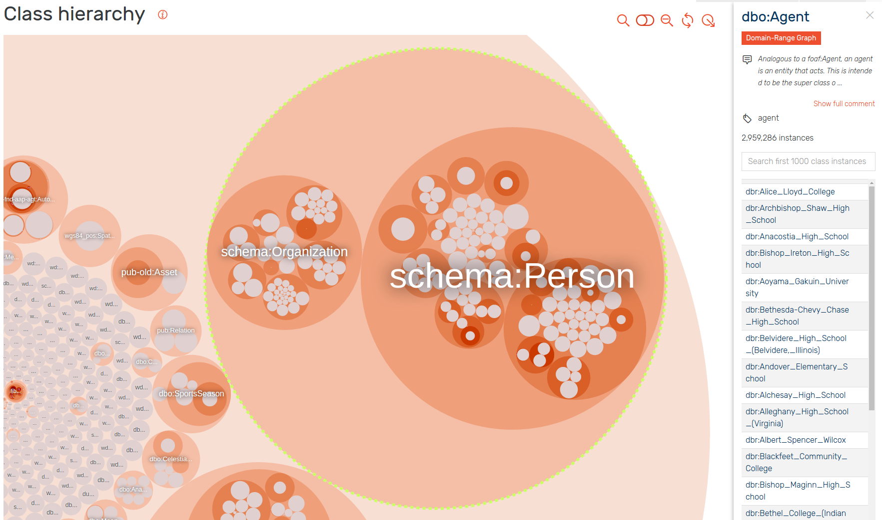
Class Exploration
About 1400 Classes
To cope with this one needs specific tools
GraphDB Workbench’s Class Hierarchy exploration tool

Slide 30
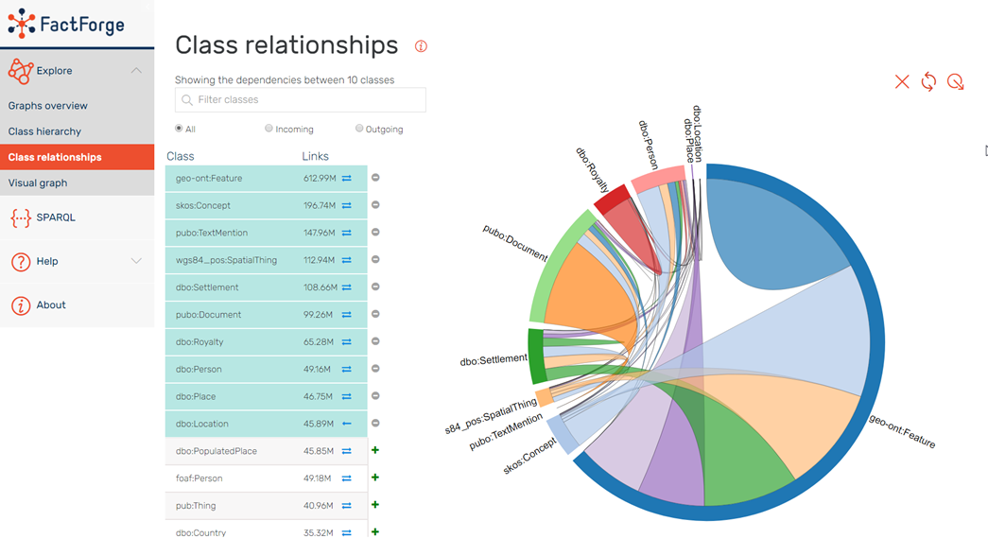
Class Relations

Slide 31
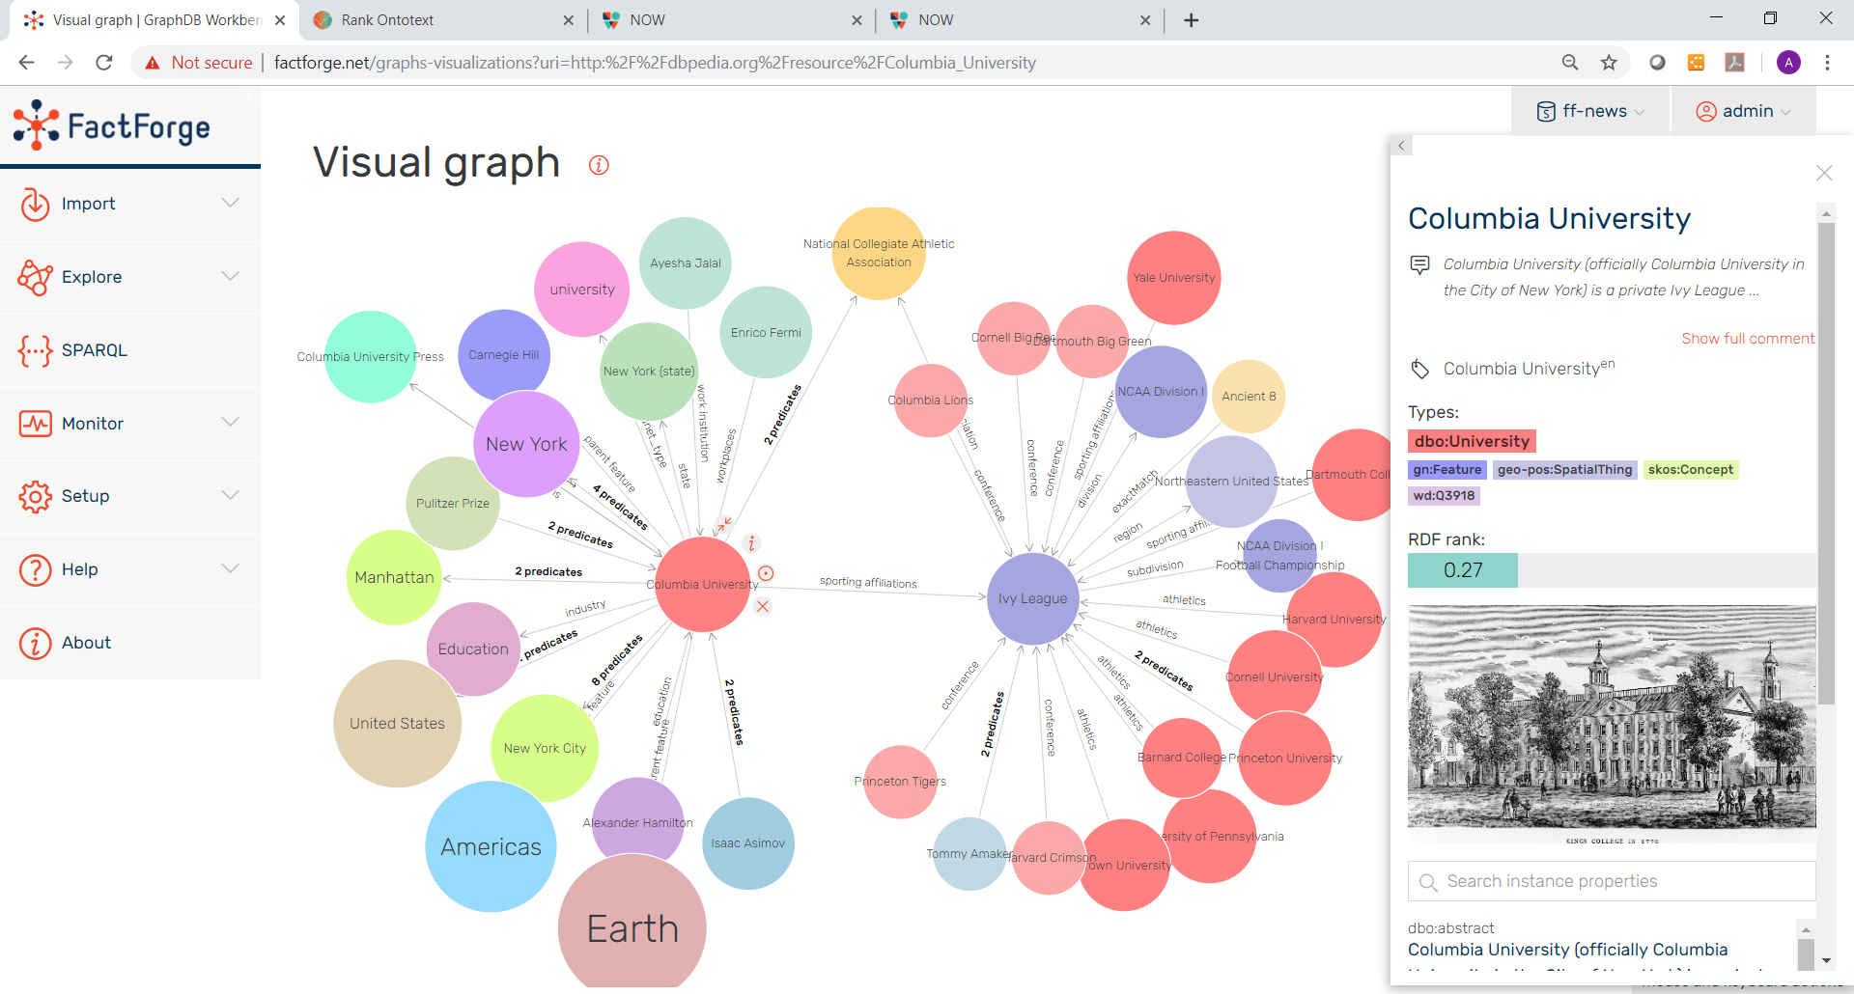
Visual Graph: Node details

Slide 32
Reference Case for GraphDB and Ontotext Platform
Big Knowledge Graph
1B statements of master data
100M entities and concepts
Entity linking across 5 data sources
1M documents, 100 KG tags/doc.
Text & Graph Analytics
Extract new entities and facts from text
Retrieval of similar documents and entities
Automatic classification and link prediction
Relevance and importance ranking
Performance
10 transactional updates/sec on master data
500 updates/sec for documents and metadata
100 graph queries/sec/node, incl. inferred facts
RDFS+ reasoning: instant and transparent
1000 full-text searches/sec across docs and data
Operations & Data Quality
Multi-DC deployment across continents
Worker nodes: 16 vCPU, 32GB RAM
Daily updates from external data sources
Maintain quality of linking and text analysis
Metadata and instance data curation
Notes:
NOTE: Change/replace “Ontotext is ready to help”
International businesses does needs global company data from market intelligence
Combining global data from multiple sources and combining it with proprietary data is not straight forward. It’s “rocket sciences”. Particularly, if you use today’s mainstream technology. The good new is that “rocket science” got democratized a lot in the recent years and new things became possible. E.g. landing the 1st stage of a rocket on a barge in the see. Dealing with global company data for market intelligence purposes also is already possible…. With semantic data integration ☺

Slide 33
Entity Awareness
What does it mean to be "aware" of something?
To have background info that allows some measure of "intelligence"?
We believe the numbers on the previous slide are a minimum that can help a machine achieve "awareness"
Let's try some games:
Airports near London (within 50 miles)
Airports near New York City
Educational institutions near New York
Educational institutions near Kaspichan

Slide 34
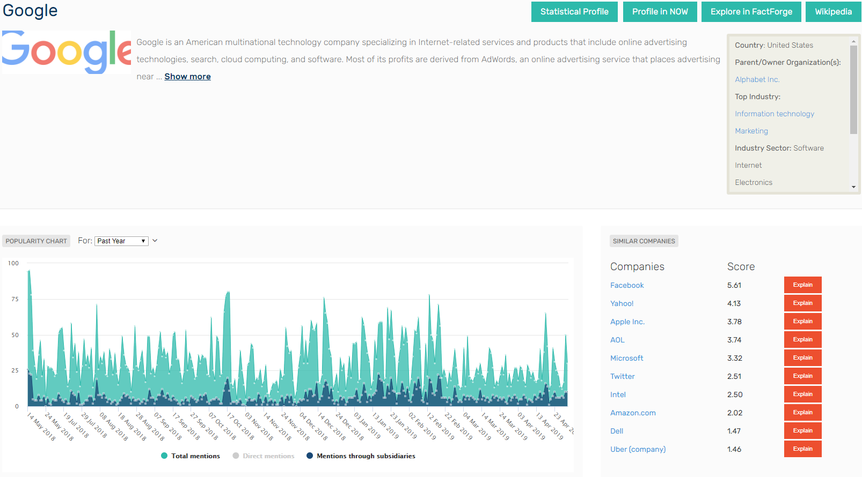
Demo: Ontotext Rank (and Similarity)

Slide 35
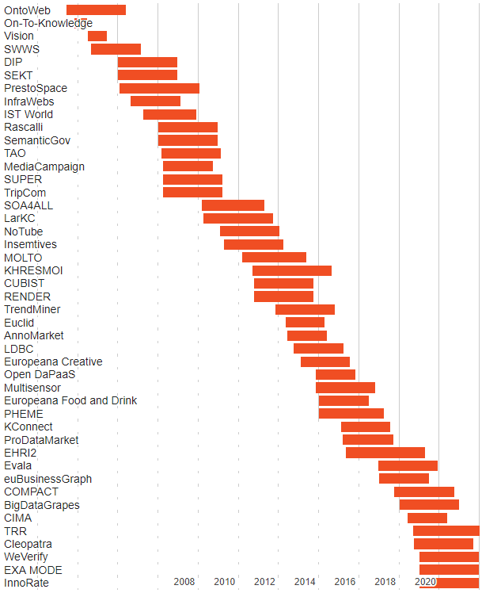
Ontotext R&D Projects
More EU research projects than some BG universities combined
Vertical domains
Cultural heritage (Europeana Creative, Food and Drink, EHRI2)
Companies (euBusinessGraph, CIMA), real estate data (PDM) (ProDataMarket)
Media/Publishing (TrendMiner, Multisensor, Evala)
Fact & rumour checking (Pheme, WeVerify)
Life Science (LarKC, KHRESMOI, KConnect, ExaMode)
Agriculture (BigDataGrapes)
Science/innovation (TRR, InnoRate)

Slide 36
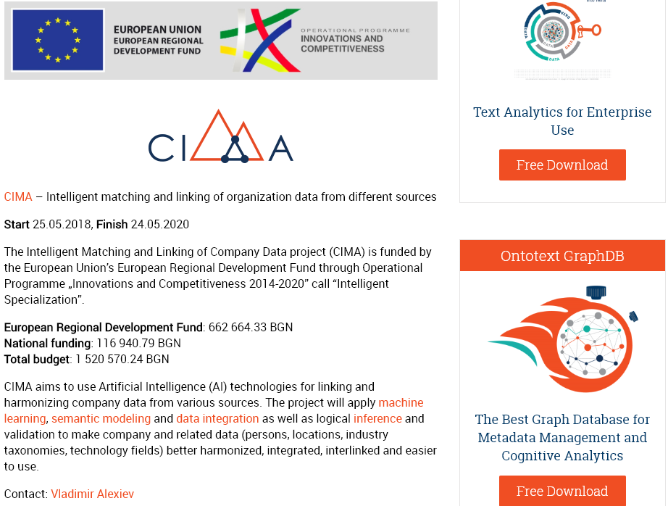
Project CIMA: Company Graph
R&D
Data virtualization (OBDA)
Entity Linking
Alignment Learning
KG Embedding and Similarity
Company Classification
Company Graph
Dataset discovery and analysis, procure datasets
Semantic structure mapping, taxonomy mapping
Semantic integration pipeline, data updates
Cognitive Entity Matching
Data curation
ML algorithms and training
Integration to Ontotext Platform, Demos
Big Data connectors (e.g. Mongo, Cassandra)
Cloud Services
Demo applications

Slide 37
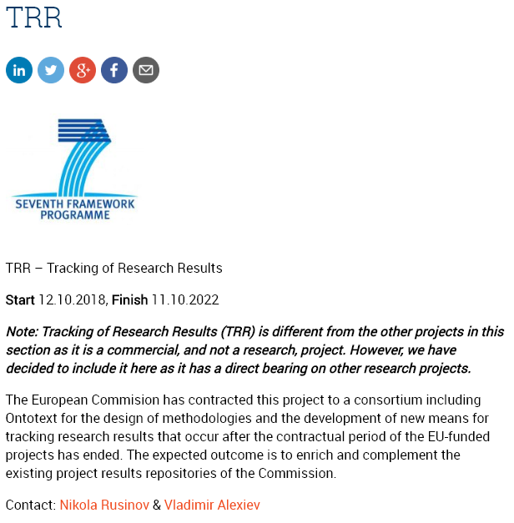
Project TRR: Science KG for FP7 Projects
Info (Wikidata): Client: EC DG RTD (ministry of science). Budget: 4M EUR, Duration: 4y. Partners: PPMI (LT), Ontotext (BG), Fraunhofer (DE), Intrasoft (LU)
Get 8000 core FP7 projects (SP1 Collaboration)
Build KG of science (projects, participants, researchers, contacts, subjects, etc)
Assess outputs (publications, datasets, patents…)
Assess outcomes (startups, collaborations, researcher mobility…)
Assess impact (on research policy, economic, societal, on health…)

Slide 38
Machine Learning at Ontotext
We're not a ML company but use ML for some of our tasks

Slide 39
ML at Ontotext
Alignment Learning for Entity Matching
Disambiguation for Named Entity Extraction
Relation Learning for Relation Extraction
Word+KG Embeddings for semantic similarity (VSA, predications)
Ranking for auto-completion, entity popularity

Slide 40
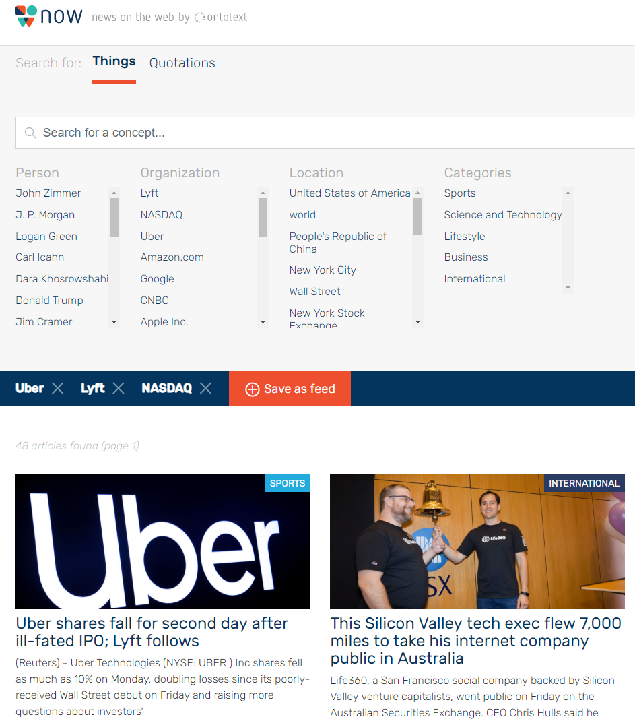
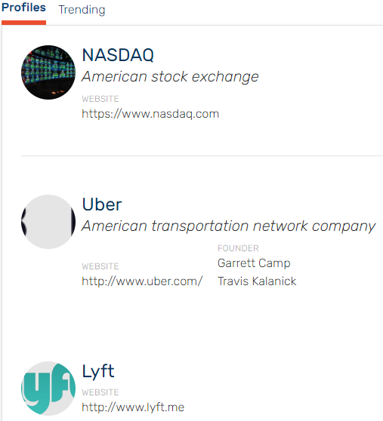
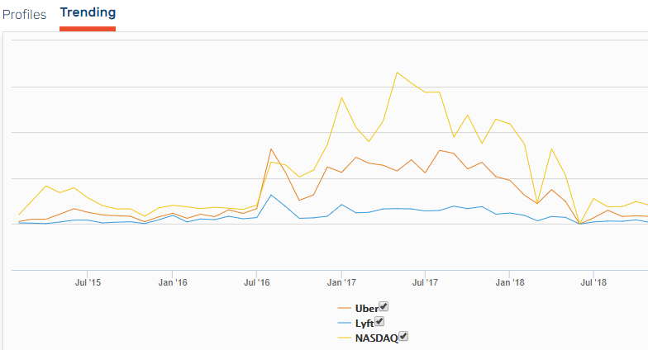
Demo: News On the Web (NOW)

Slide 41
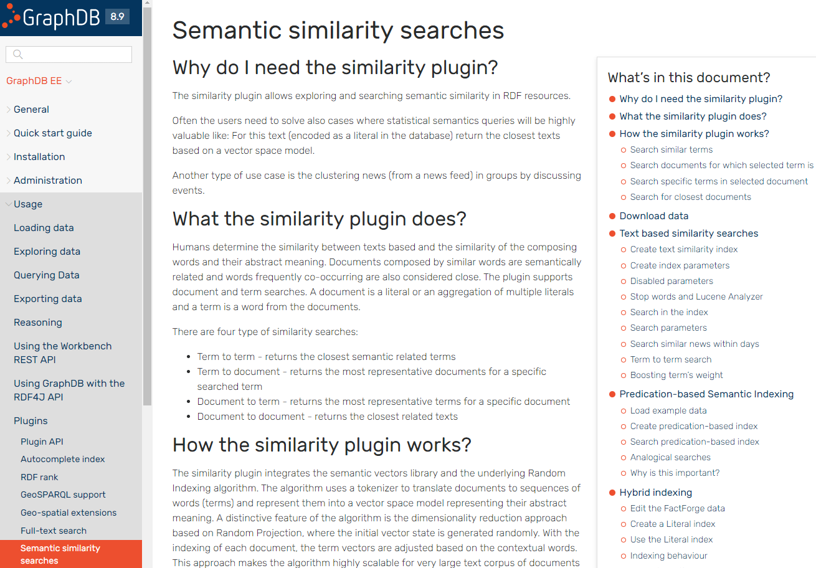
GraphDB Semantic Similarity (Mar 2019)
create hybrid similarity searches
use pre-built text-based similarity vectors
predication-based similarity index
run similarity indexes in more that one iterations
add term weights when searching text-based similarity indexes
use analogical search for predication indexing

Slide 42
New Developments in Bulgaria
Collaborations Between Academia and Industry

Slide 43
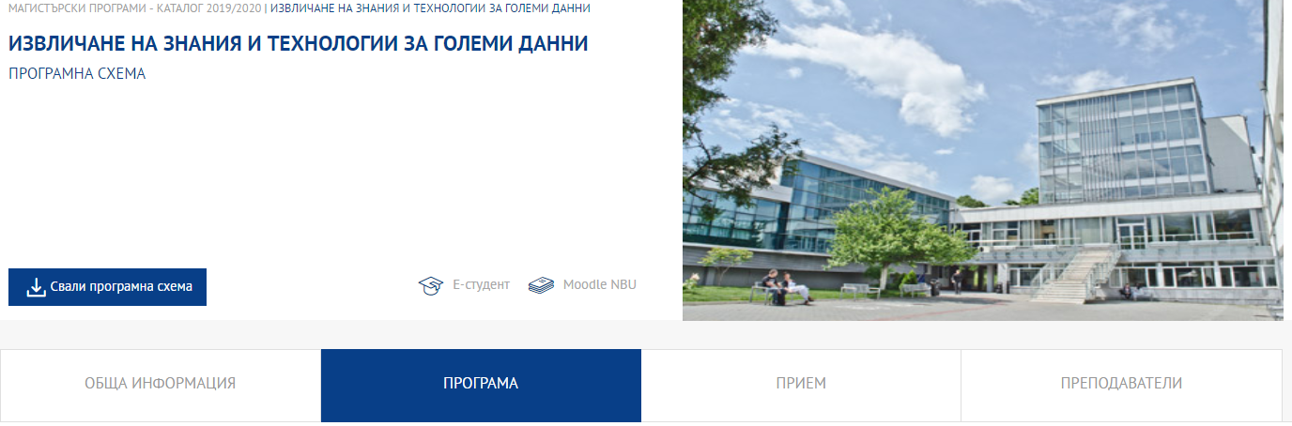
NBU MS Data Science
Starts Sep 2019
Covers ML, mathematics, R, Python, distributed (Spark), cloud…
Ontotext course: Semantic Web Proof of Concept
IICT BAS course: Semantic Text Analysis

Slide 44
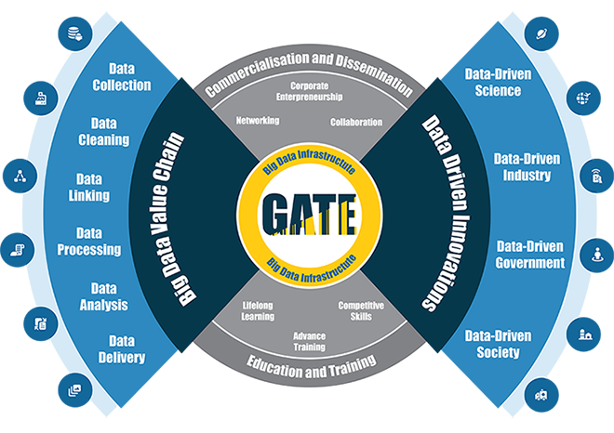







GATE CoE: SU FMI + Chalmers Teaming
Host
Teaming
Industry Supporters

Slide 45
Thank you!
Контакти:
Ontotext: Website, LinkedIn, Twitter, Rate GraphDB
Vladimir Alexiev: Email, Publications, Homepage, Resume, Linkedin; Twitter, Github
Следващо събитие:
Repeatability and reproducibility of ML research

